Slide 1

Leaders in Environment Analysis and Definition of Strategy

Slide 2
[Emre, Insert the video here]

Slide 3
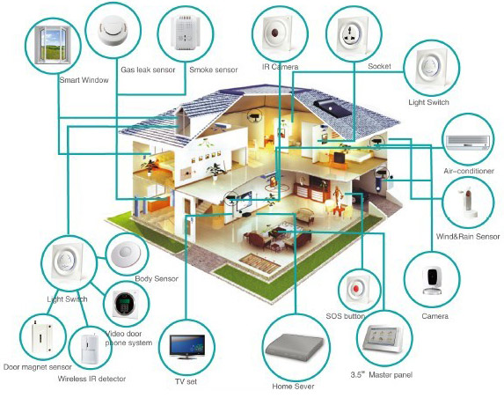
Source: http://smarthomeenergy.co.uk/what-smart-home

Slide 4
Smart Homes
Connectivity
Comfort
Individualism
Climate contol
Data Technology

Slide 5
Input
Time
Output
Digital Report
Outcomes
Global strategy for Smart Homes
Knowlegde
Effort
Funds
Git Record
Printed Report

Slide 6
Leaders in Environment Analysis and Definition of Strategy

